Slide 1
Electronic Devices and Circuits Lecture-1
CSE 223
Prepared by
Ipshita Tasnim Raha
Lecturer (Provisional)
Dept. of CSE
Varendra University

Slide 2
Varendra University Department of Computer Science and Engineering
Program | B. Sc. In Computer Science and Engineering
Course Code: | CSE
Course Title: | Electrical Devices and Circuits
Section | A, B, C
Semester | 4th Semester, Summer 2020
Prerequisite: | Basic Physics ( PHY 111), Electrical Circuits (CSE 121)
Number of Credit: | 3
Course Teacher: | Ipshita Tasnim Raha Lecturer (Provisional), Dept. of CSE, Varendra University Cell: 01715673436 Email: ipshita@vu.edu.bd, ipshita032@gmail.com
Lecture Hours: | 1 Hour 25 Minutes, two theoretical lectures per week
Textbook: | Electrical Devices and Circuit theory by Robert_L._Boylestad Principles of Electronics by V.K. Mehta and Rohit Mehta
Reference book | Electrical Devices and Circuits by A. Mottershead Electrical Devices and Circuits by Jacob Millman and Christos C. Halkias

Slide 3
Mark Distribution
Attendance | 10%
Contineous Assessment (Quiz) | 10%
Contineous Assessment (Assignment) | 10%
Mid Case study Presentation Viva | Total 30% 10% 10% 10%
Final Case study Presentation Online exam/ Quiz | Total 40% 10% 10% 20%

Slide 4
Mark Distribution
Assessment Tools |  | Marks (%)
Contineous Assessment (CA) | Class participation | 10% | 40%
 | Class Test, Assignment, Project, Discussion, Presentation | 30%
Summative Assessment (SA) | Mid-term Examination | 24% | 60%
 | Final Examination | 36%

Slide 5
Syllabus
Course Code: CSE 223
Course Title: Electrical Devices and Circuits
Pre-requisite: Basic Physics, Electrical Circuits.
Course Content: Introduction to semiconductors, p-type and n-type semiconductors, p-n junction diode characteristics, Forward and reverse biased p-n junction
Diode applications: half and full wave rectifiers, clipping and clamping circuits, regulated power supply using zener diode.
Bipolar Junction Transistor (BJT): principle of operation, I-V characteristics; Transistor circuit configurations (CE, CB, CC), BJT biasing load lines; Small-signal analysis of single and multi-stage amplifiers.
Field Effect Transistors (FET): principle of operation of JFET and MOSFET and its characteristics; biasing of FETs, switching circuits using FETs, Introduction to CMOS.
Operational Amplifiers (OP AMP): Characteristics and application of OPAMP, gain, input and output impedances
Silicon Controlled Rectifiers (SCR), DIAC : characteristics and applications;
Introduction to IC fabrication processes.

Slide 6
Course Outcomes (Cos)
 | Description | POs | Taxonomy domain/ level | Delivery Method | Assessment tools
CO1 | Describe the basic semiconductor devices and their characteristics. | PO1 | Cognitive/ Understand | Lecture, Textbook | Midterm Exam
CO2 | Illustrate the operation principles of transistor and its different circuit configurations. | PO2 | Cognitive/ Analyze | Lecture, Textbook | Class Test
CO3 | Demonstrate the application of field effect transistors. | PO1 | Cognitive/ Apply | Lecture, Textbook | Class Test/ Assignment
CO4 | Analyze different circuit based on op-amp and their applications. | PO2 | Cognitive/ Analyze | Lecture, Textbook | Final Exam

Slide 7
General Instruction
Class attendance is mandatory.
Home works will be provided at the end of each class. Home works must submit before the next class on MS Team.
Must read the previous lecture and next lecture before joining the class.
Class Assignment will be provided at due time before the midterm exam and final exam. Assignment must submitted before due date on MS Team. No assignment will be counted for marks/Points after the due date.

Slide 8

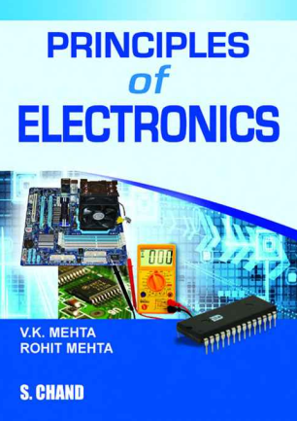
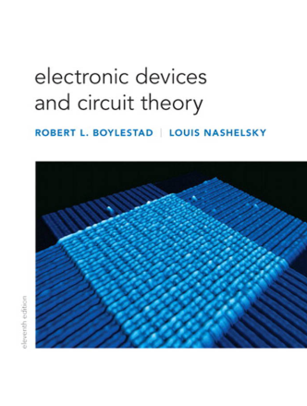
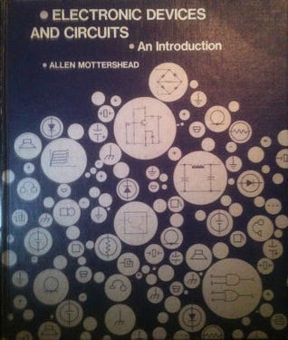
Text Book

Slide 9
Introduction to Semiconductors

Slide 10
Semiconductor
Semiconductors are a special class of elements having a conductivity between that of a good conductor and that of an insulator
In general, semiconductor materials fall into one of two classes:
Single-crystal Semiconductors: It have a repetitive crystal structure. Such as, Germanium (Ge) and Silicon (Si) have a repetitive crystal structure.
Compound Semiconductors: It is constructed of two or more semiconductor materials of different atomic structures. Such as, Gallium Arsenide (GaAs), Cadmium Sulfide (CdS), Gallium Nitride (GaN) and Gallium Arsenide Phosphide (GaAsP) are compound semiconductors.

Slide 11
Semiconductor
The three semiconductors used most frequently in the construction of electronic devices are Ge, Si, and GaAs.
Sl | Substance | Nature | Resistivity
1 | Copper | Good conductor | 1.7X10⁻⁸ Ωm
2 | Germanium | Semiconductor | 0.6 Ωm
3 | Glass | Insulator | 9X10¹¹ Ωm
4 | Nichrome | Resistance material | 10⁻⁴ Ωm

Slide 12
Properties of Semiconductor
The resistivity of a semiconductor is less than an insulator but more than a conductor
Semiconductor has negative temperature co-efficient of resistance i.e. the resistance of a semiconductor decreases with the increase in temperature and vice versa.
When a suitable metallic impurity is added to a semiconductor its current conducting properties change appreciably.

Slide 13
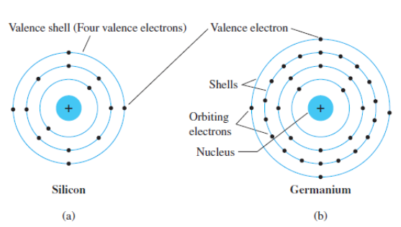
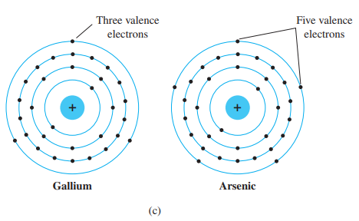
COVALENT BONDING
The fundamental components of an atom are the electron, proton, and neutron. In the lattice structure, neutrons and protons form the nucleus and electrons appear in fixed orbits around the nucleus.
The electron configuration of the most used three semiconductors are given below,
Fig: Atomic structure of (a) silicon; (b) germanium; and (c) gallium and arsenic.

Slide 14
COVALENT BONDING
Here, silicon has 14 orbiting electrons, germanium has 32 electrons, gallium has 31 electrons and arsenic has 33 orbiting electrons.
For germanium and silicon there are four electrons in the outermost shell, which are referred to as valence electrons. Gallium has three valence electrons and arsenic has five valence electrons.

Slide 15
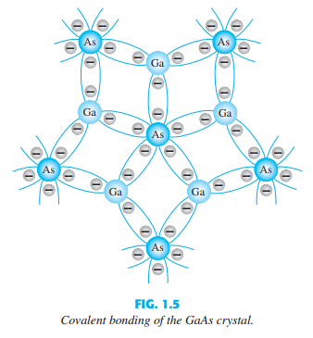
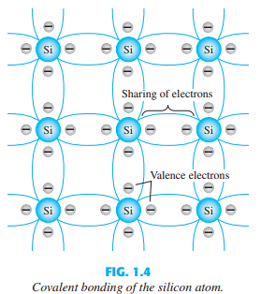
COVALENT BONDING
In a pure silicon or germanium crystal the four valence electrons of one atom form a bonding arrangement with four adjoining atoms. This bonding of atoms, strengthened by the sharing of electrons, is called covalent bonding.

Slide 16
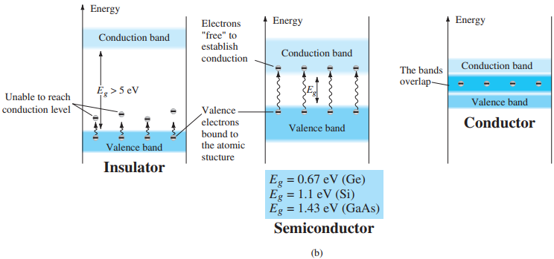
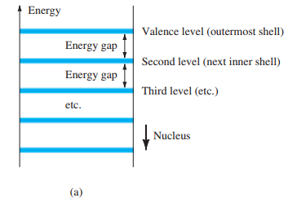
Energy Levels
Within the atomic structure of each and every isolated atom there are specific energy levels associated with each shell and orbiting electron.
Fig: Energy levels: (a) discrete levels in isolated atomic structures
(b) conduction and valence bands of an insulator, a semiconductor and a conductor.

Slide 17
Valence Band, Conduction Band and Forbidden Energy Gap
Let’s watch a video
Link: https://www.youtube.com/watch?v=ANr1wgYLVRo

Slide 18
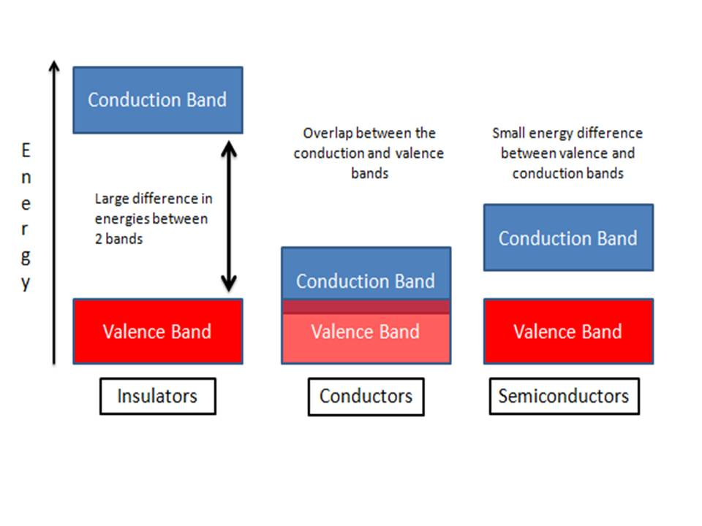
Energy Levels

Slide 19
Energy Bands Of Semiconductor
Energy gap is different for Ge, Si and GaAs. Ge has the smallest gap and GaAs the largest gap. In total, this simply means that, An electron in the valence band of silicon must absorb more energy than one in the valence band of germanium to become a free carrier. Similarly, an electron in the valence band of gallium arsenide must gain more energy than one in silicon or germanium to enter the conduction band.
Therefore, relatively small energy is needed by their valence electrons to cross over to the conduction band. Even at room temperature, some of the valence electrons may acquire sufficient energy to enter into the conduction band and thus become free electrons. However, at this temperature, the number of free electrons available is very small. Therefore, at room temperature, a piece of germanium or silicon is neither a good conductor nor an insulator. For this reason, such substances are called semiconductors.

Slide 20
Effects Of Temperature On Semiconductor
At absolute zero temperature semiconductor behaves as a perfect insulator.
Above zero temperature some of the covalent bonds in semiconductor break due to the thermal energy supplied. For this reason some of the electrons become free. The result is that a few free electrons exist in semiconductor. These free electrons can constitute a tiny electric current if potential difference is applied across the semiconductor crystal. This shows that the resistance of a semiconductor decreases with the rise in temperature.

Slide 21
Intrinsic and Extrinsic Semiconductors
Let’s watch a video
Link: https://www.youtube.com/watch?v=ORP71zqFf1k
https://www.youtube.com/watch?v=JBtEckh3L9Q

Slide 22
Intrinsic Semiconductor
In an intrinsic semiconductor valence electron may absorb the sufficient kinetic energy from external natural causes to break the covalent bond and assume the free state. The external causes include effects such as light energy in the form of photons and thermal energy (heat) from the surrounding medium. At room temperature there are approximately 1.5x10¹⁰ free carriers in 1cm³ of intrinsic silicon material, that is 15billion electrons in a space smaller than a small sugar cube, which is enormous.
Hole-electron pairs are created.
When electric field is applied across an intrinsic semiconductor

Slide 23
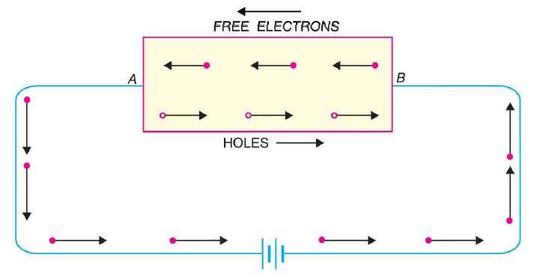
Intrinsic Semiconductor

Slide 24
Intrinsic and Extrinsic Semiconductors
Any semiconductor material in its extremely pure form is termed as intrinsic semiconductor. No electron is found in the conduction band of an intrinsic semiconductor material to take part in conduction. Example of Intrinsic Material is Silicon, Germanium.
The conductive characteristic of an intrinsic semiconductor can be altered significantly by adding a small amount of suitable impurity atoms into it. The process of adding impurities to intrinsic semiconductor is known as doping. And an intrinsic semiconductor material that has been subjected to the doping process is called an extrinsic semiconductor material.
Depending upon the type of impurity added, extrinsic semiconductors are classified into two types. They are,
n-type semiconductor
p-type semiconductor

Slide 25
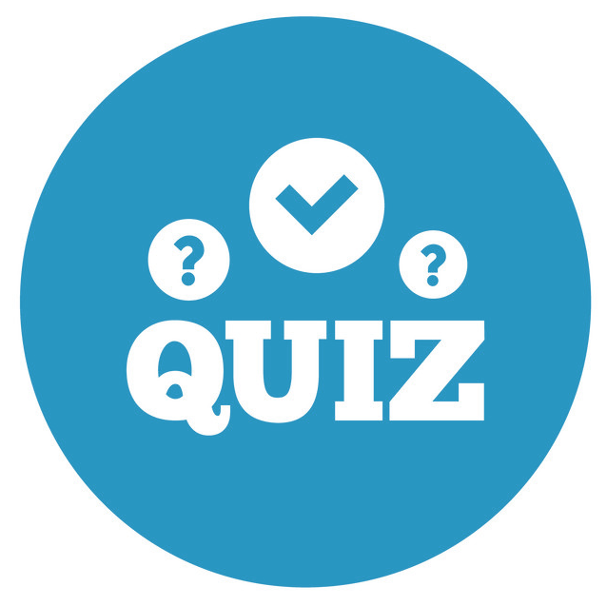
Quiz Time!
A brief assessment
Don’t Worry!
A quiz is a form of game or mind sport.

Slide 26
What is semiconductor?
Name any three most frequently used semiconductors.
What are the fundamental components of an atom?
What is covalent bonding?
At absolute zero temperature semiconductor behaves as a perfect __________
the resistance of a semiconductor _________ with the rise in temperature.
Why do we add suitable impurity atoms into an intrinsic semiconductor?
What is doping?
What is Valence Band, Conduction Band and Forbidden Energy Gap?

Slide 27
Work Hard
Stay Humble

Slide 28
Thanks!
Any questions?
You can find me at:
ipshita032@gmail.com

